Slide 1

SPEECH JAMMER
Semester II (2021-2022)
Embedded Systems Course
Final Project Presentation
Course Code: CPE316
Supervisors: Dr. Iman Elawady ; ENG. Michael B.Khani
Team MEGATRONS members:
Umut Asmaz (1810205077@ogrenci.karabuk.edu.tr)* | Selen Çeğil (1810205086@ogrenci.karabuk.edu.tr)
Sedanur Çevik (1810205034@ogrenci.karabuk.edu.tr) | Ahmet Can (1810205090@ogrenci.karabuk.edu.tr)
Emrah Akgöğ (1810205067@ogrenci.karabuk.edu.tr) | Umutcan Çetinkaya (1910205048@ogrenci.karabuk.edu.tr
Ervanur Gürler (1810205050@ogrenci.karabuk.edu.tr) | Büşra Kartal (2017010205027@ogrenci.karabuk.edu.tr)

Slide 2

Contents
Introduction
Objectives
Conclusion
Project Design
References
Related Works
Application
Goals
Summary
Software
Hardware
Challenges
Results
Future works (Optional)

Slide 3
Introduction

Slide 4
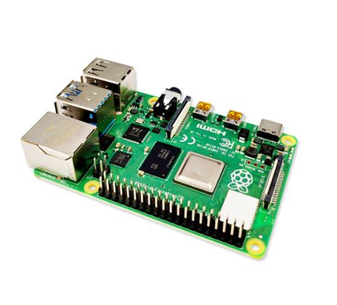
Introduction
Summary
Using Raspberry pi4, whose codes we created with python, we made a prototype that instantly weakens the speech ability.
In principle, we made use of the Delayed Auditory Feedback effect to make speech difficult.
We can use this system we have made with any device that has an audio input or output. We preferred a wired headset.

Slide 5
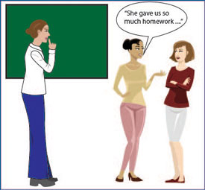
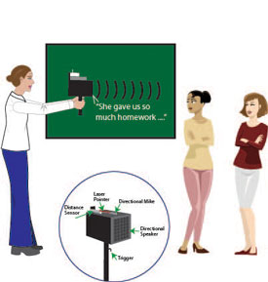
Introduction
Goals
Our aim is to use this device in places where silence is required, preventing people from speaking and keeping them quiet.
When we speak in our normal life, we hear our own voice again with a slight delay. We adjust our speech to these sensations. Since our brains have evolved and adapted accordingly from birth, if we delay our speech even more and send it back to ourselves, our brain will act unusually, we will be confused and have difficulty speaking. This allows us to be quiet.

Slide 6
Related Works

Slide 7
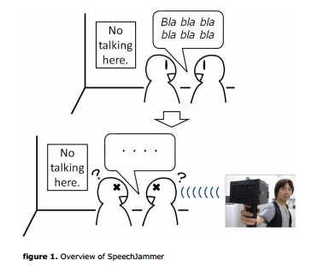
Related Works
We connect our headset to our Raspberry pi4 card. We connect the card to the computer to run our code. We activate the application. Our voice received with the microphone is delayed by 200 ms and transferred back to us from the headphones. By making use of the Delayed Auditory Feedback effect, we extend the time between speech and auditory perception and provide a modified feedback.
While 'delayed auditory feedback' prevents normal speakers from speaking, it is used for treatment in stutterers. The person's muscles are relaxed, and fluency is achieved by trying to control stuttering and speaking more slowly.
On the other hand, there are various softwares that enable the speech blocking effect to be experienced easily, with the same logic. It is also produced in the form of a target-oriented weapon using a distance sensor, microphone, speaker.

Slide 8
Project Design

Slide 9

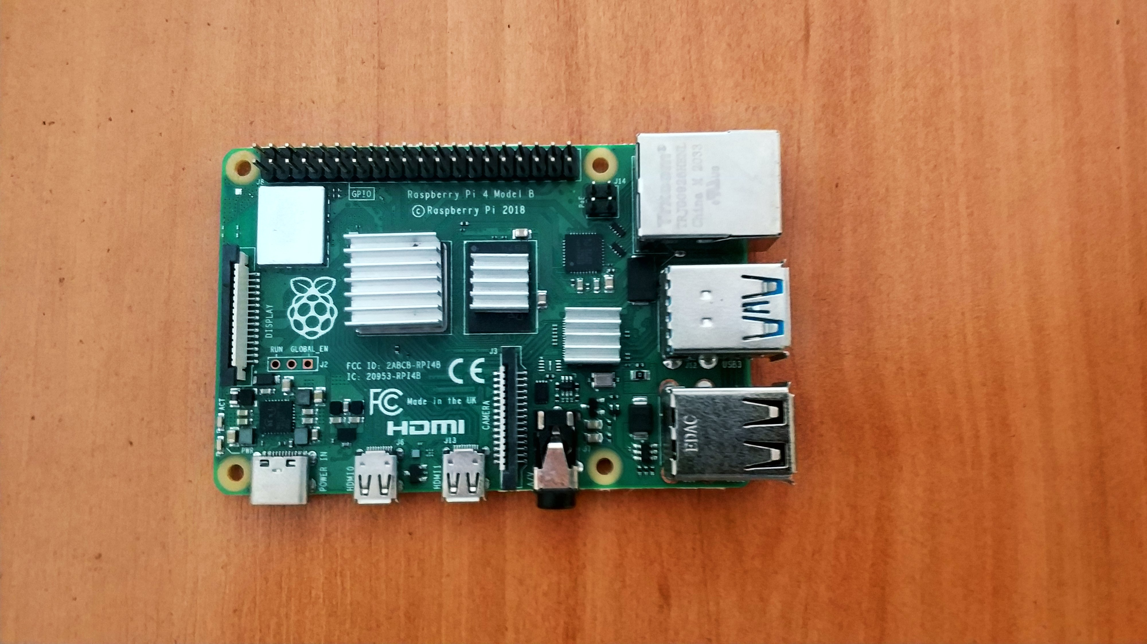
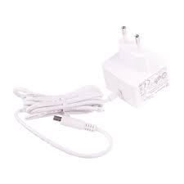
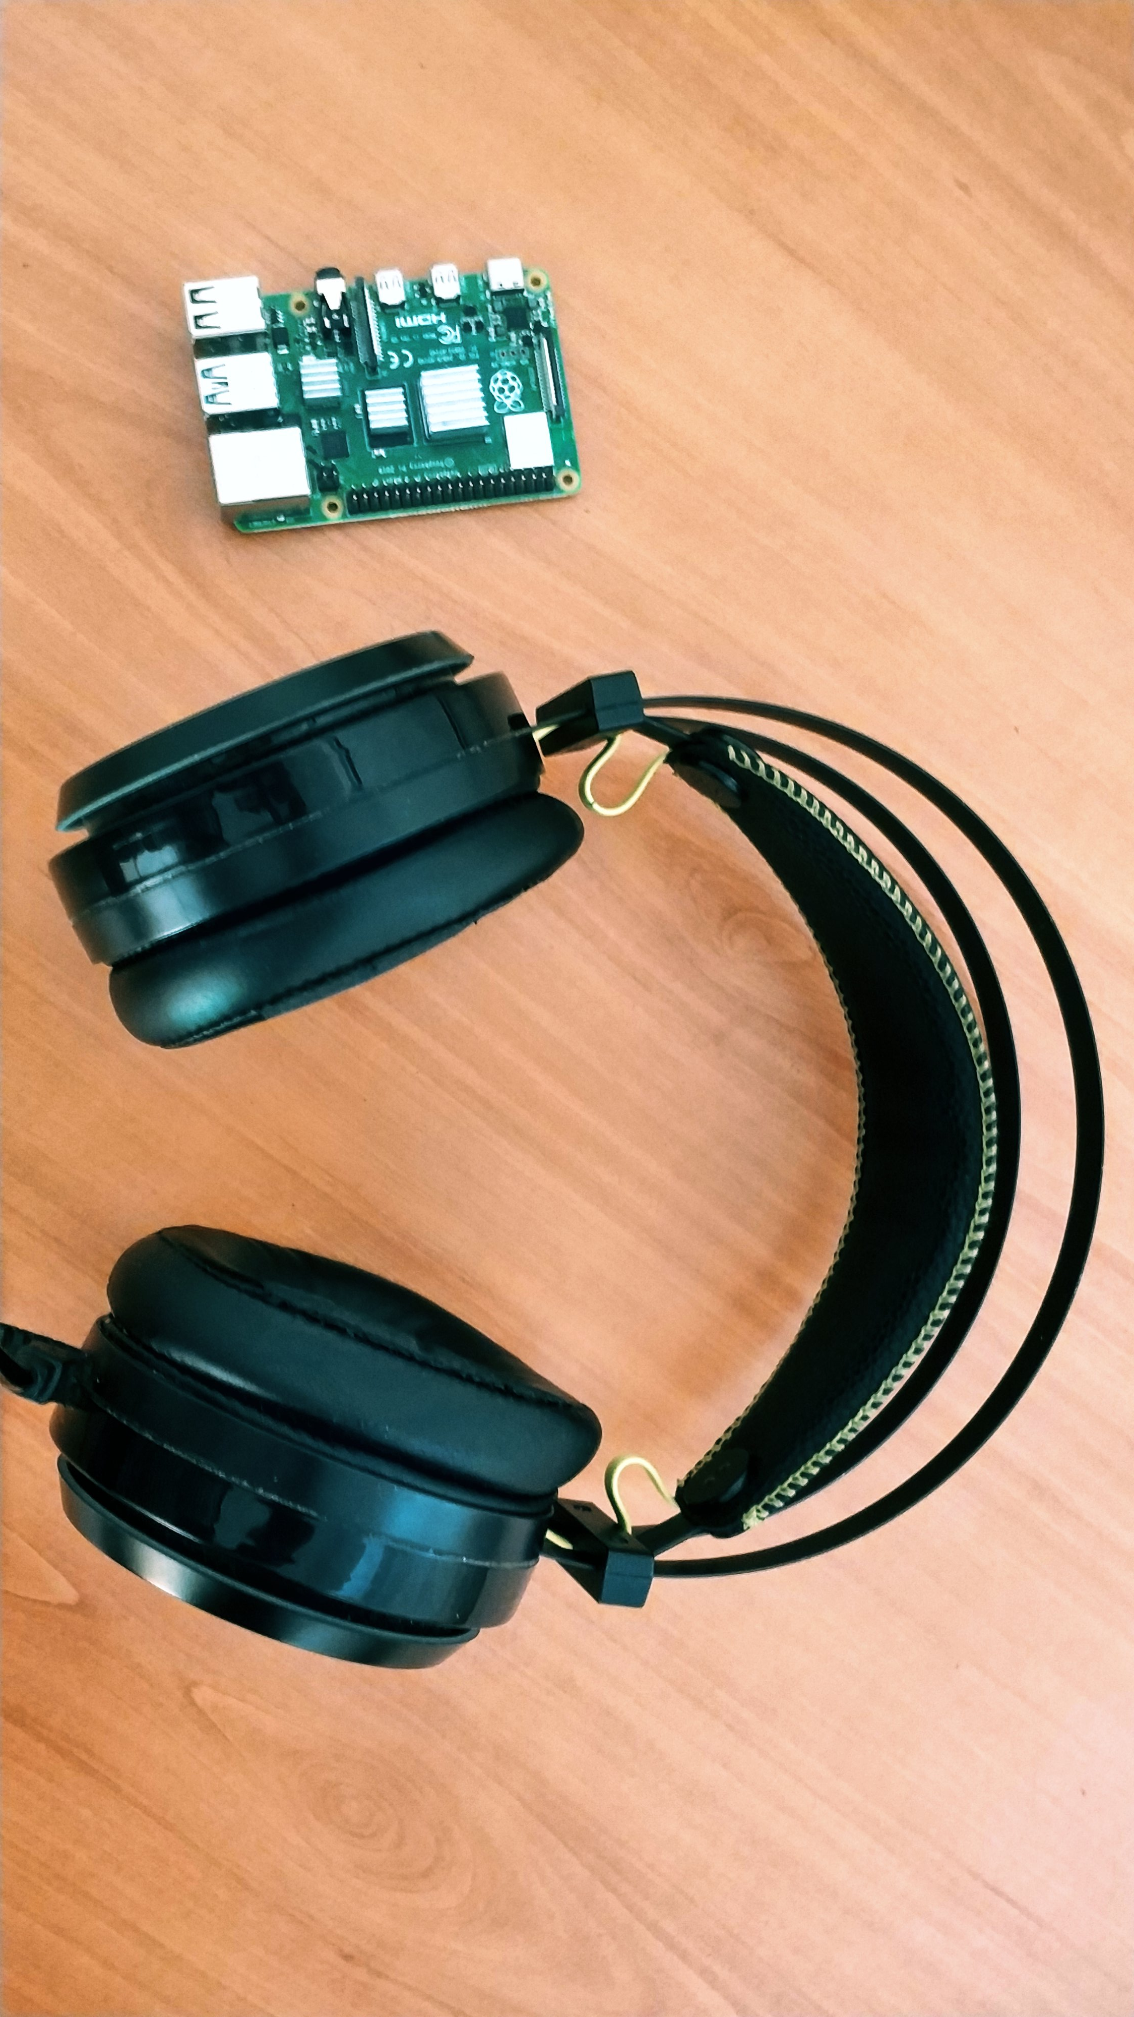
Project Design
Project Mechanism
The project consisted of a Raspberry pi4, a wired headset, a power adapter, and a software written in python.
Wired headset is connected to the audio input/output.
Anything with an audio output can be used instead of a headphone.
We can use 3 or 4 in Raspberry pi. We preferred to use Raspberry pi 4.
We can use a power bank in the power adapter or a power that produces 5 Volts and 3 Amps DC current.

Slide 10
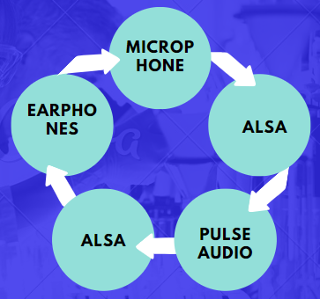
AUDIO TRANSMISSION
ALSA: used to identify the audio device to the hardware.
PULSEAUDIO: audio server.

Slide 11
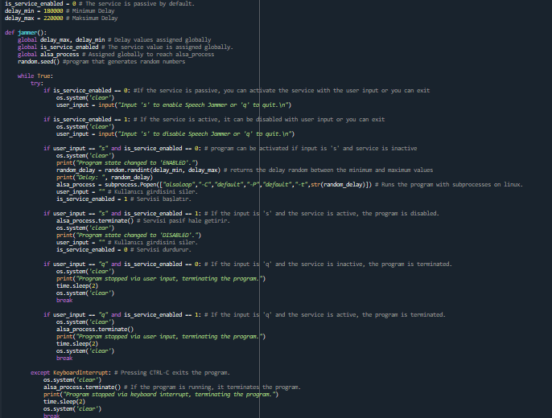
Project Design

Slide 12
Conclusion

Slide 13
Conclusion
If we evaluate the objectives of the project, how the project makes it difficult for individuals to talk, and our observations during the testing phase of the project:
Trying with a separate microphone and headphones as hardware could provide better perception and transfer of sound.
The fact that we had insufficient knowledge caused us to have difficulties in what we would do as a team.

Slide 14
References
https://www.physicscentral.com/explore/action/speech-jam.cfm

Slide 15
Finish.

